Slide 1


Slide 2
Group 7
ALFIN - 1901457366
FELICIA STELLA - 1901465733
MERY ANGELYA - 1901460026
STEVANUS CORNELIUS - 1901478250
TRIASADI PRANATA - 1901470102

Slide 3
Presentation outcome
Company profile
Database planning
System definition
Database design
User interface

Slide 4
Company profile

Slide 5

Business information
Business Name : CLOTHE & CLEAN
Business Address : Kemanggisan Street no.170,
West Jakarta
Email : clothenclean@gmail.Com
Tel : 021-6327688

Slide 6
Business information
General Business Activities
CLOTHE & CLEAN is established as a laundry service company in Kemanggisan Street of West Jakarta, Indonesia. Located at a densely populated and busy area, CLOTHE & CLEAN offers the assurance of fast, convenient, and professional laundry service. CLOTHE & CLEAN has different laundry service package options which are designed to best suit the customer’s needs. To ensure the service quality and professionalism, all the laundry operational transactions data are stored in a database specifically programmed to support the daily laundry service operations. All the products used in the laundry cleaning service are environmentally friendly products that efficiently clean every different type of fabric.

Slide 7
COMPANY STRATEGY
Purpose
To be a leader in the laundry business by providing convenient and enhanced laundry services.
Vision
To provide quality laundry services that exceeds the expectations of our esteemed customers.
Mission statement
To build long term relationships with our customers and provide exceptional customer services through innovation and professionalism.

Slide 8
COMPANY STRATEGY
Core values
We believe in treating our customers professionally with respect and faith.
We are eager to improve through our entire customer’s critics and advice.
We grow through creativity, innovation, and technology in our services.
We integrate honesty, integrity and business ethics into all aspects of our business services

Slide 9
goals
Regional expansion in the field of laundry service business.
Increase the assets of the company to support the development of services.
To build good reputation of laundry service business and maintain long-lasting relationship with our customers.

Slide 10
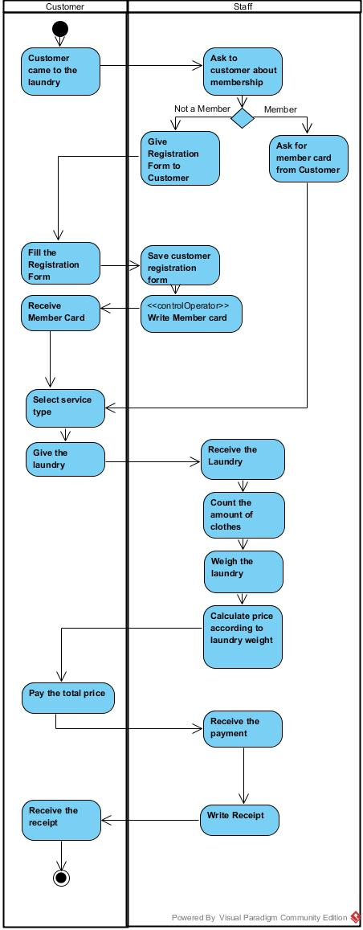
Business process WITHOUT SYSTEM

Slide 11
Database planning

Slide 12
Mission statements
To support customer data
To support the recording of transactions
To support financial reports
To support analytical reports

Slide 13
Mission objectives
To Support Customer Data
A. Create Customer Data
B. Display Customer Data
To Support the Recording of Transactions
A. Create Data Order
B. Display Total Price
C. Create Receipt
To Support Financial Reports
A. Generate Monthly Revenue and Expense Report
To Support Analytical Reports
A. Generate Annual Analytical Report

Slide 14
Documentation that will be needed to support the database:
1. Receipts
2. Registration Form

Slide 15
Data that will be recorded to the database:
Customer Data
Staff Data
Service Type Data
Sales Data

Slide 16
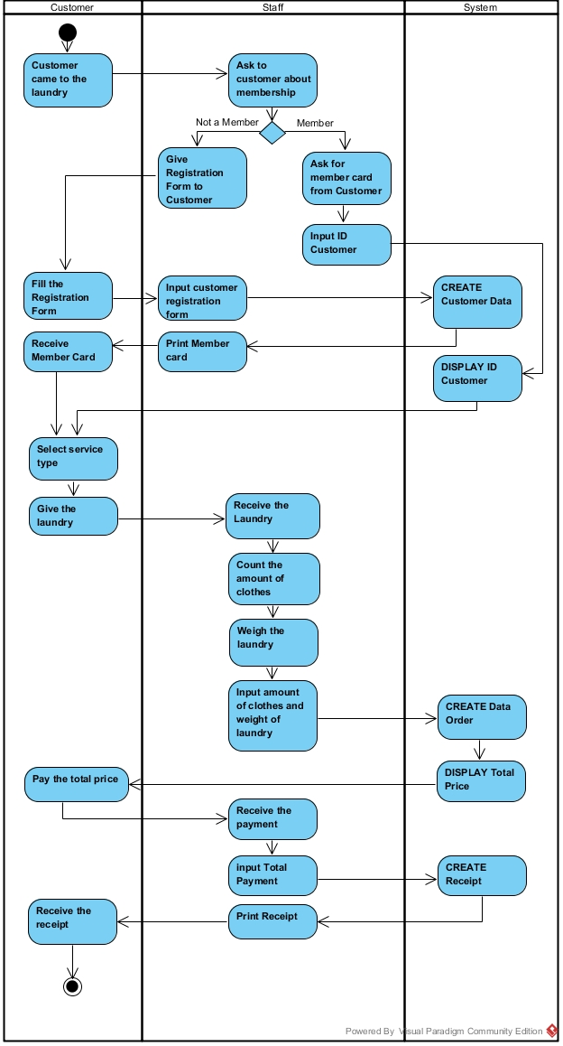
Business process WITH SYSTEM

Slide 17
System definition

Slide 18
System definition
 | Customer | Staff | Owner | IT | Accounting
Sales |  |  | ✓ | ✓ | ✓
Staff |  |  | ✓ | ✓
Customer | ✓ | ✓ | ✓ | ✓
Clothes | ✓ | ✓ | ✓ | ✓
Service Type | ✓ | ✓ | ✓ | ✓

Slide 19
Database design

Slide 20
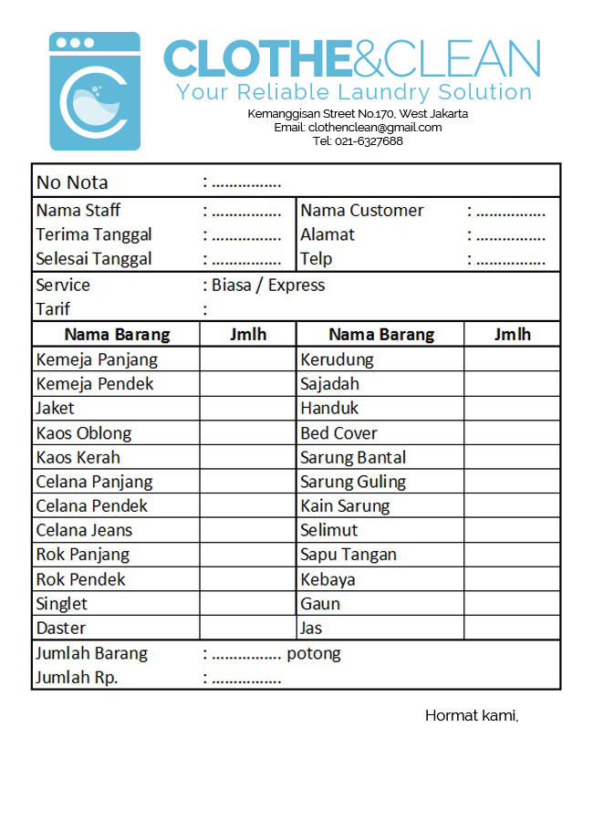
receipt

Slide 21
normalization
UNF TrLaundry : (ID_Trans, tglTerima, tglAmbil, namaMember, alamatMember, telpMember, namaStaff, {namaBrg, jumlahPerBrg}, tarif, totalBrg, harga, serviceType_Name)
1NF TrLaundry : (ID_Trans, tglTerima, tglAmbil, namaMember, alamatMember, telpMember, namaStaff, tarif, totalBrg, serviceType_Name) TrDetail : (ID_Trans, ID_Brg, namaBrg, jumlahPerBrg)
2NF TrLaundry : (ID_Trans, tglTerima, tglAmbil, namaMember, alamatMember, telpMember, namaStaff, tarif, totalBrg, serviceType_Name) TrDetail : (ID_Trans, ID_Brg, namaBrg, jumlahPerBrg) MsBarang : (ID_Brg, namaBrg)

Slide 22
normalization
3NF TrLaundry : (ID_Trans, tglTerima, tglAmbil, totalBrg, ID_Member, ID_Staff, ID_ServiceType) TrDetail : (ID_Trans, ID_Brg, namaBrg, jumlahPerBrg) MsBarang : (ID_Brg, namaBrg) MsMember : (ID_Member, namaMember, alamatMember, telpMember) MsStaff : (ID_Staff, namaStaff, alamatStaff, telpStaff) MsServiceType : (ID_ServiceType, serviceType_Name, tarif)

Slide 23
conceptual database design
MsServiceType
MsMember
TrLaundry
MsPakaian
MsStaff
TrDetail

Slide 24
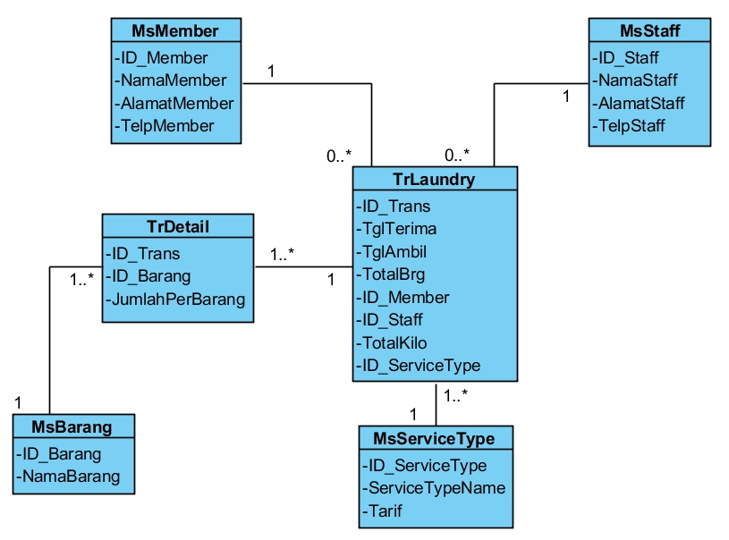
Logical er modeling

Slide 25
User interface

Slide 26


Slide 27
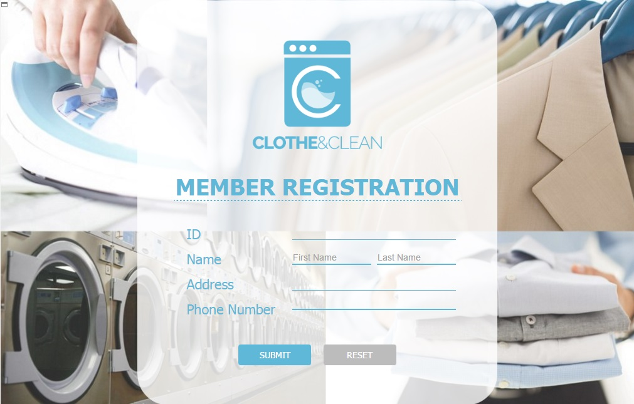

Slide 28
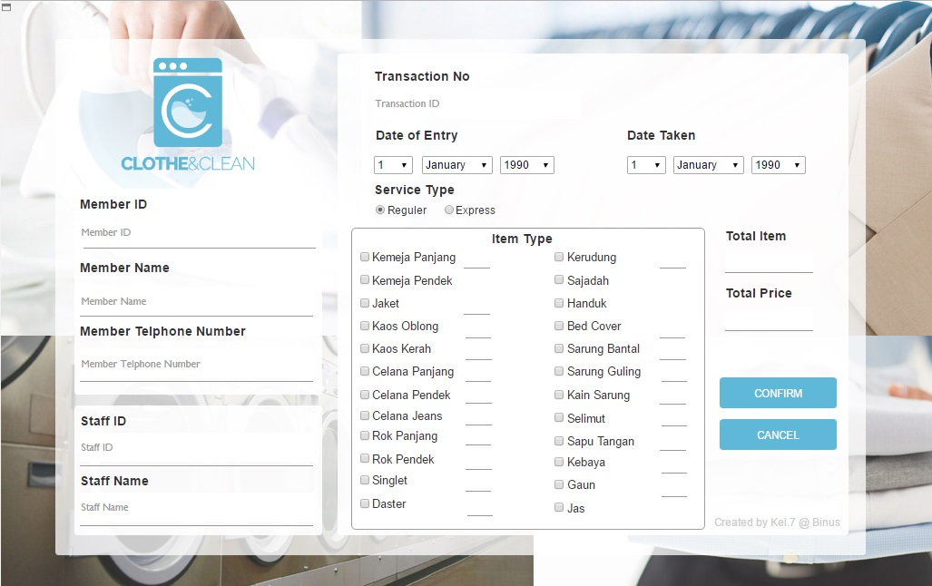

Slide 29
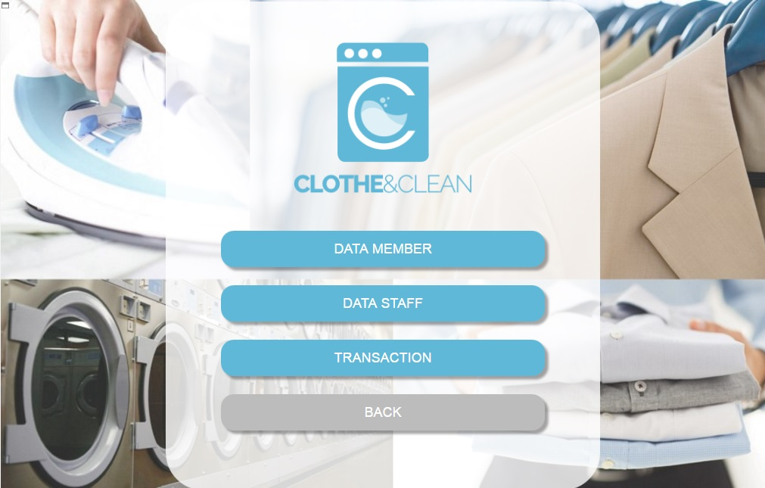

Slide 30
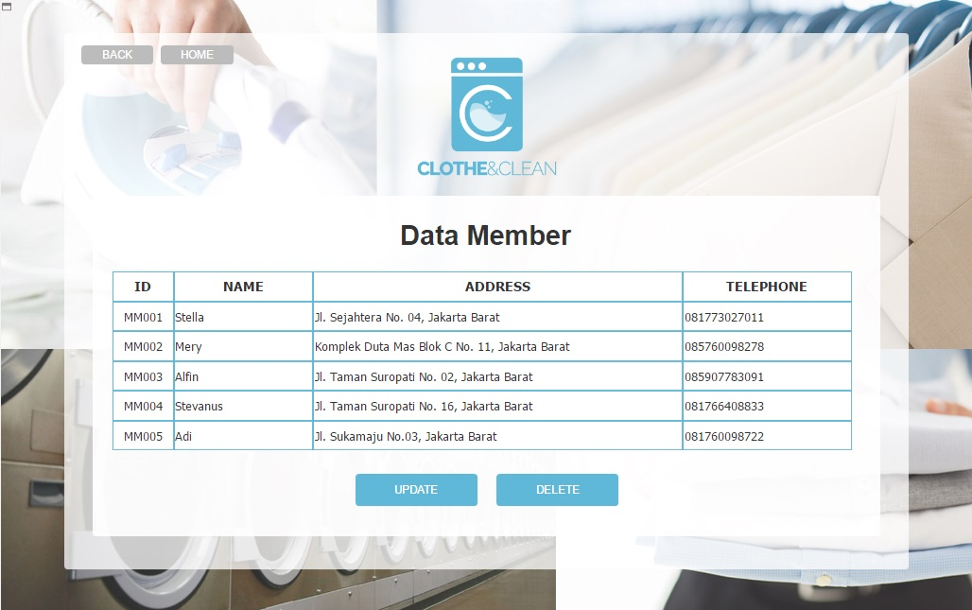

Slide 31
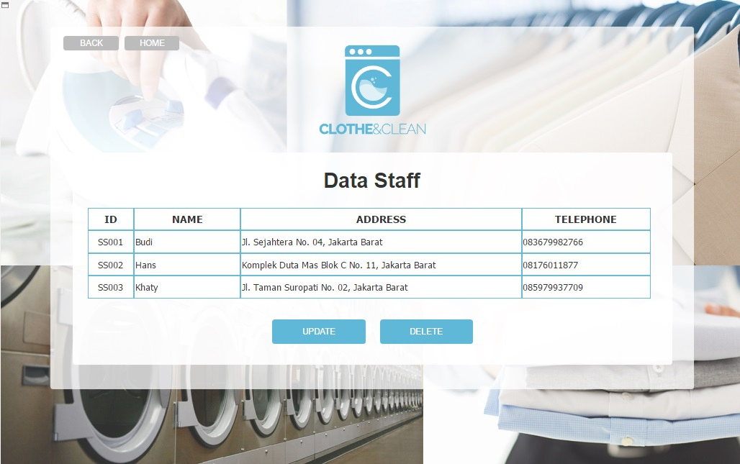

Slide 32
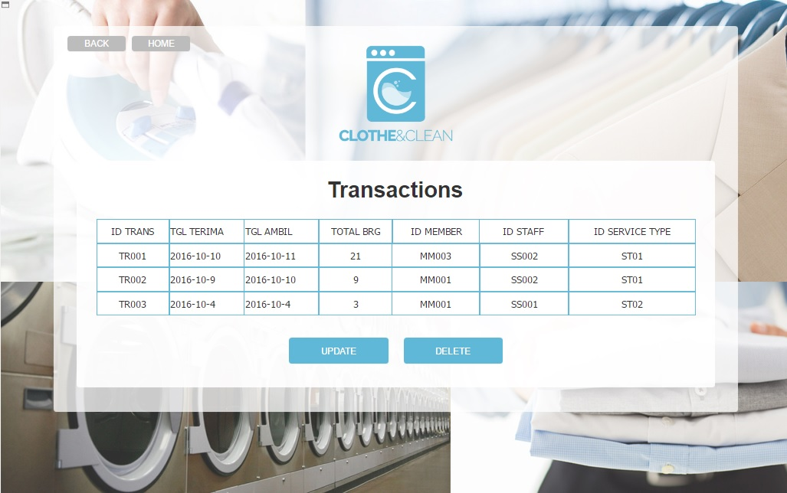

Slide 33
Thank you

